Slide 1
Advanced Computer Architecture Numericals

Slide 2
Q1. A program is run on 40 MHZ cpu with the instruction mix and corresponding clock cycle count as given in the table below. Determine
Effective CPI.
Execution time.
MIPS rate for the program.
Instruction Type | Clock Cycle Count | Instruction count
Integer Arithmetic | 1 | 45000
Floating Point | 2 | 32000
Data Transfer | 2 | 15000
Control Transfer | 2 | 8000

Slide 3
Q2. Calculate the average CPI when the following conditions are given:
Instruction Type | Clock Cycle Count | Relative Frequency
I | 2 | 30%
II | 3 | 25%
III | 5 | 40%
IV | 10 | 5%

Slide 4
Q3. Suppose that the same program is executed on two different machines A and B. Compilers and data sets on both the computer are same. Given that-
Machine –A: Avg CPI= 3.5, Cycle time= 1.0ns.
Machine- B: Avg CPI= 1.2, Cycle time= 0.5ns.
Which of the machine is slower?
Q4. A CPU renders a graphic image in 100ms with graphic card –A and 125ms with graphic card-B. What is the speed up?

Slide 5
Q5. Consider the execution of object code with 200,000 instruction on a 40 MHz processor. The program consists of four major types of instruction. The instruction mix and number of cycles(CPI) needed for each instruction type are given below:
Calculate the avg CPI and MIPS.
Instruction Types | CPI | Instruction Mix
Arithmetic and logic | 1 | 60%
Load/ store and cache hit | 2 | 18%
Branch | 4 | 12%
Memory reference | 8 | 10%

Slide 6
Q6. Consider the following data for two machines A and B.
Compare A and B in terms of CPI and clock cycles.
 | #k register instruction(1 cycle each) | #k Memory Access instruction(2 cycle each) | #k floating point instruction(3 cycle each)
Machine A | 2 | 1 | 2
Machine B | 4 | 1 | 1

Slide 7
Q7. A hardware manufacturer company increases the frequency from 700 MHZ to 1.2 GHZ. What is the potential speed- up achieved?
Q8. Machine A has clock cycle time of 1 ns and an avg CPI of 2. Machine B has clock cycle time of 2 ns and an avg CPI of 1.2. Instruction count is same, then which of the two machines is faster?

Slide 8
Q9. Which of the two computers appears faster if it is used to run prog-x and prog-y:
50% of the time.
90% and 10% of the time respectively.
When would computer-A appear faster than computer- B?
 | Time on Comp- A | Time on Comp- B
Prog- x | 1 | 10
Prog-y | 1000 | 100

Slide 9
Q10. For a RISC machine with the following instruction mix:
If a CPU design enhancement improves the CPI of load instruction from 5 to 2, what is the performance improvement from this enhancement?
Operation | Frequency | Cycles | %Time
ALU | 50% | 1 | 23%
Load | 20% | 5 | 45%
Store | 10% | 3 | 14%
Branch | 20% | 2 | 18%

Slide 10
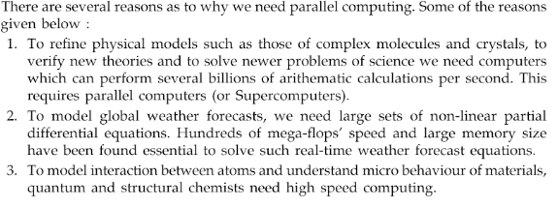
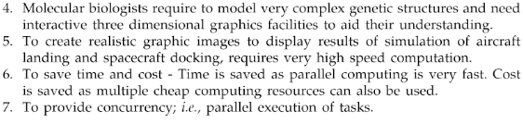
Need for Parallel Computing:

Slide 11
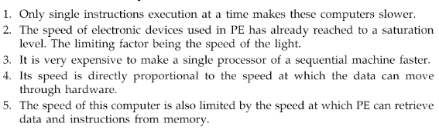
Limitations of Sequential Machine:

Slide 12
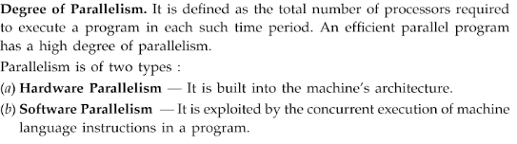

Slide 13
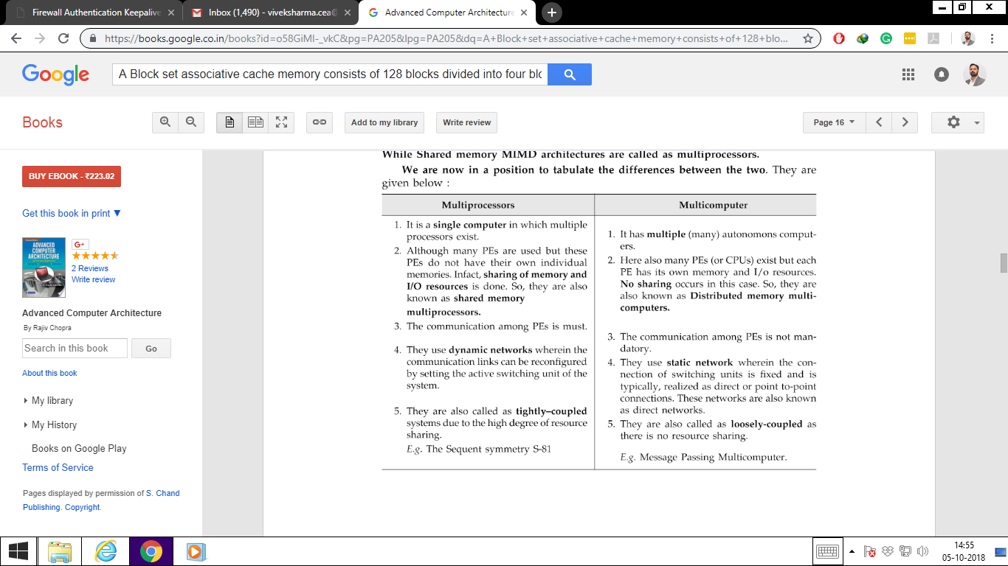
Multiprocessor vs Multicomputer

Slide 14
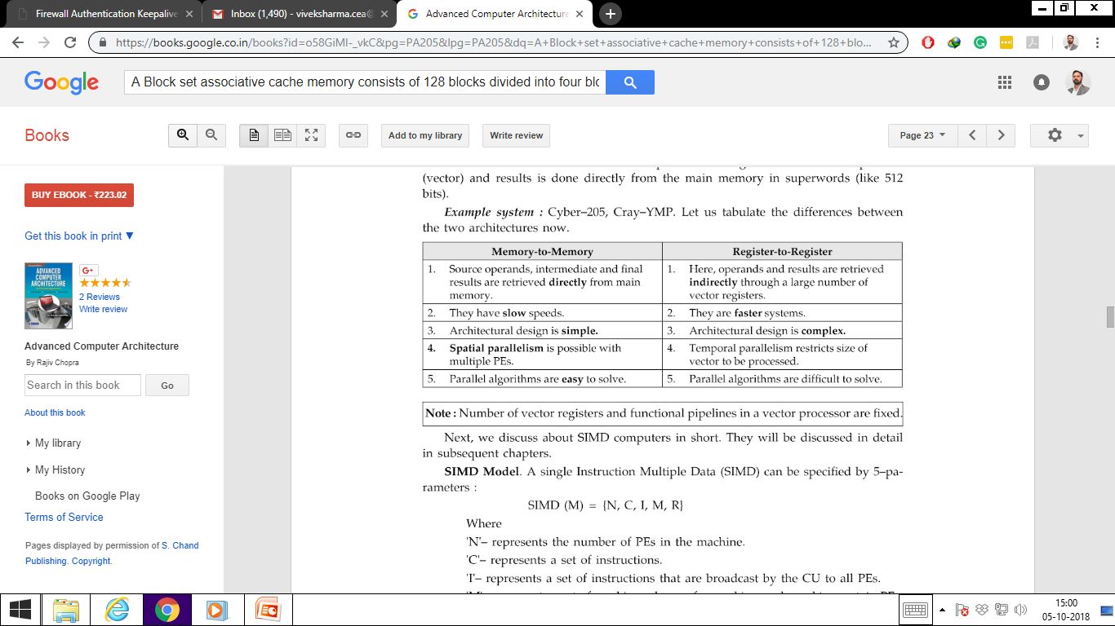
Types of Vector Supercomputer or Multicomputer

Slide 15
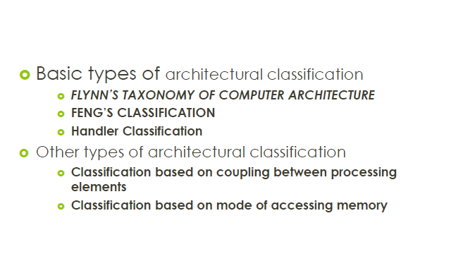

Slide 16
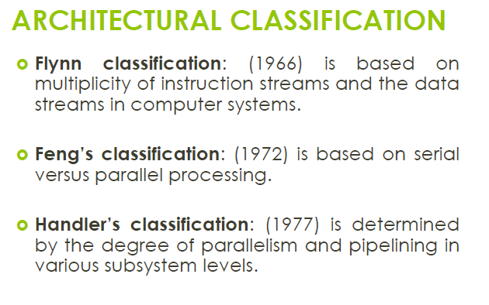

Slide 17
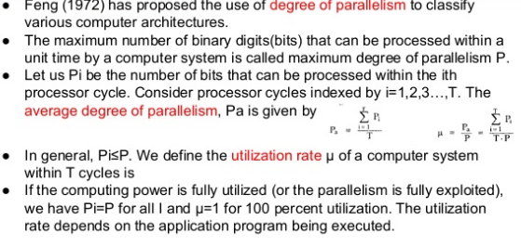
Feng’s Classification

Slide 18
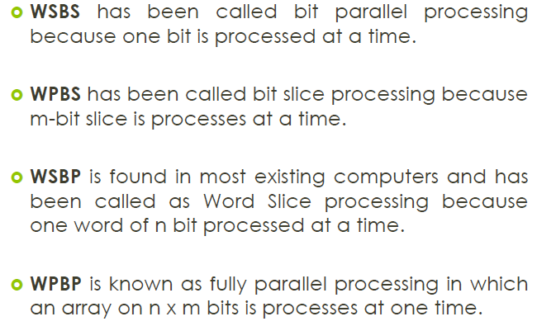

Slide 19
Handler’s Classification:
In 1977, Wolfgang Handler proposed an elaborate notation for expressing the pipelining and parallelism of computers. Handler's classification addresses the computer at three distinct levels:
Processor control unit (PCU),
Arithmetic logic unit (ALU),
Bit-level circuit (BLC).

Slide 20
The PCU corresponds to a processor or CPU, the ALU corresponds to a functional unit or a processing element and the BLC corresponds to the logic circuit needed to perform one-bit operations in the ALU.
Handler's classification uses the following three pairs of integers to describe a computer:
Computer = (p * p', a * a', b * b')

Slide 21
Computer = (p * p', a * a', b * b')
Where p = number of PCUs
Where p'= number of PCUs that can be pipelined
Where a = number of ALUs controlled by each PCU
Where a'= number of ALUs that can be pipelined
Where b = number of bits in ALU or processing element (PE) word
Where b'= number of pipeline segments on all ALUs or in a single PE

Slide 22
Texas Instrument's Advanced Scientific Computer (ASC) has one controller coordinating four arithmetic units. Each arithmetic unit is an eight stage pipeline with 64-bit words. Thus we have:
ASC = (1, 4, 64 * 8)
The Cray-1 is a 64-bit single processor computer whose ALU has twelve functional units, eight of which can be chained together to from a pipeline. Different functional units have from 1 to 14 segments, which can also be pipelined. Handler's description of the Cray-1 is:
Cray-1 = (1, 12 * 8, 64 * (1 ~ 14))

Slide 23
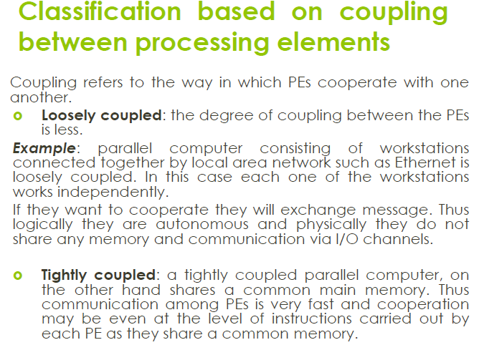

Slide 24
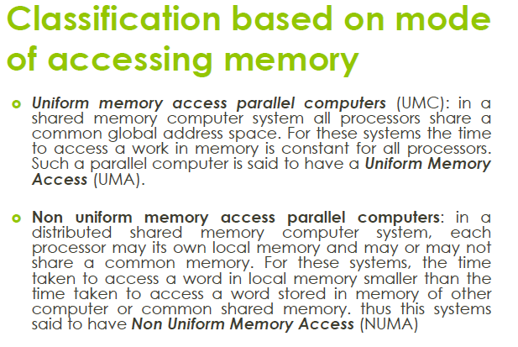

Slide 25
Classification based on grain size:
Grain Size: The quantum of work done by PE before it communicates with other processor is called grain size.
This will corresponds to the number of instruction executed by PE before it sends result to cooperating PE.
Grain Size is classified as:
Very fine grain.
Fine grain.
Medium grain.
Course grain.

Slide 26
1) Very fine grain or Instruction level: This is the lowest level and the degree of parallelism is highest at this level. The fine grain size is used at instruction or statement level as only few instructions form the grain size here. For example, for scientific applications, the instruction level grain size may be higher. As the higher degree of parallelism can be achieved at this level, the overhead for a programmer will be more.
2) Fine grain or Loop Level : This is another level of parallelism where iterative loop instructions can be parallelized. Simple loops in a program are easy to parallelize whereas the recursive loops are difficult. This type of parallelism can be achieved through the compilers.
3) Medium grain or Procedure/ Sub Program Level: This level consists of procedures, subroutines or subprograms. This level contains some thousands of instructions in a procedure. Multiprogramming is implemented at this level. Parallelism at this level has been exploited by programmers but not through compilers. Parallelism through compilers has not been achieved at the medium and coarse grain size.
4) Course grain or Program Level: It is the last level consisting of independent programs for parallelism. This level contains tens of thousands of instructions. Time sharing is achieved at this level of parallelism. Parallelism at this level has been exploited through the operating system.

Slide 27
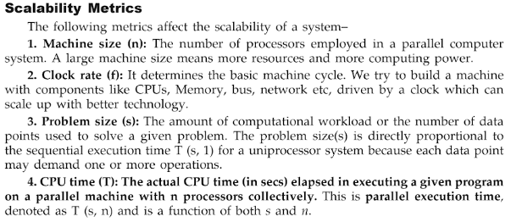

Slide 28
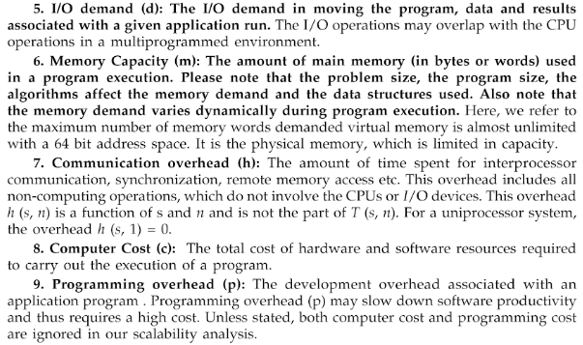

Slide 29
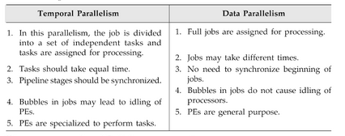

Slide 30
